Slide 1
Multiple Linear Regression

Slide 2
Agenda/Topics
Multiple linear regression – Problem formulation
Interpretation of coefficients, and their p-values
Adjusted R²
Matrix form and solution, H matrix
Risks
Multicollinearity
VIF
Outliers, influence , leverage
Cook’s distance, DEFITS
Selecting subset of parameters for final model
Underfit ? Overfit?

Slide 3
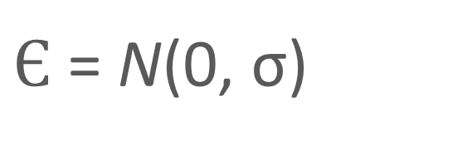
Problem Formulation
Population model

Slide 4
Estimation through Sample
What is interpretation of b_{j}
Change in y per unit change in corresponding x parameter
When everything else is held constant
Residual

Slide 5
Matrix formulation of the Model
y₁ = b₀ + b₁x_{1,1} + b₂ x_{1,2} + ….+b_{p-1} x_{1,p-1}+ є₁
y₂ = b₀ + b₁x_{2,1} + b₂ x_{2,2} + ….+b_{p-1} x_{2,p-1} + є₂
y₃ = b₀ + b₁x_{3,1} + b₂ x_{3,2} + ….+b_{p-1} x_{3,p-1} + є₃
---------------------------------------------------------------------
y_{n} = b₀ + b₁x_{n,1} + b₂ x_{1,2} + ….+b_{p-1} x_{n,p-1} + є₄
y = Xb + є

Slide 6
Closed form Solution
b = (X^{T}X)⁻¹X^{T}Y
= X (X^{T}X)⁻¹X^{T}Y
H = X (X^{T}X)⁻¹X^{T}
Hat matrix !

Slide 7

Components of Result
Adjusted
Pvalue of R²
^{MSE}
^{Pvalue of the coefficients}
^{VIF of the parameters}
^{Residual Analysis – LINE}

Slide 8
Risk - 1
Multi-collinearity:
If the p-1 features are not linearly independent
Rank of X < p-1
Rank of X^{T}*X < p-1
Inverse of X^{T}*X does not exist
No fixed Solution
Messed up interpretation of b_{j}
Change in y per unit change in corresponding x parameter
When everything else is held constant
Inflated variance

Slide 9
Risk 2 :Outliers, leverage and influence
Outlier –
data point with unusual y value
High Leverage point -
data point with extreme X value
High influence point –
data point with potential to significantly impact the fit

Slide 10
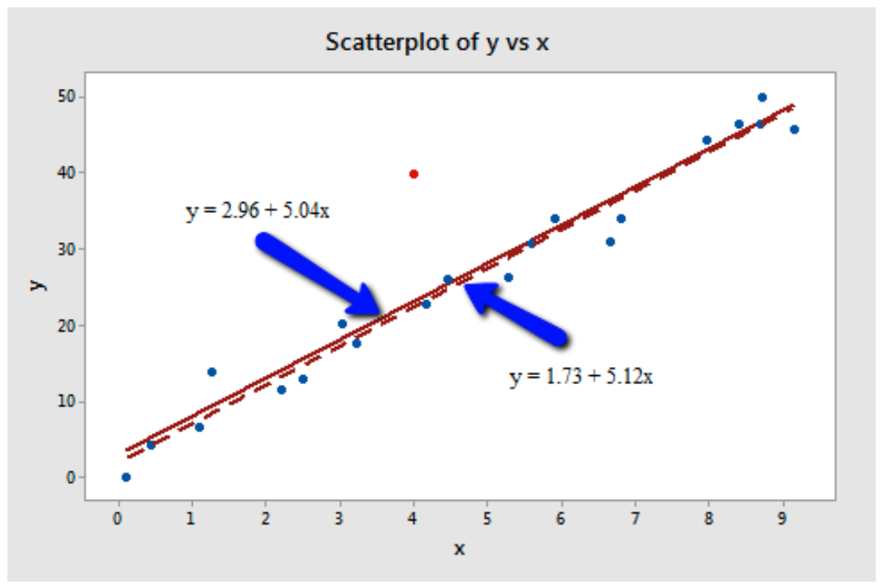
Outlier

Slide 11
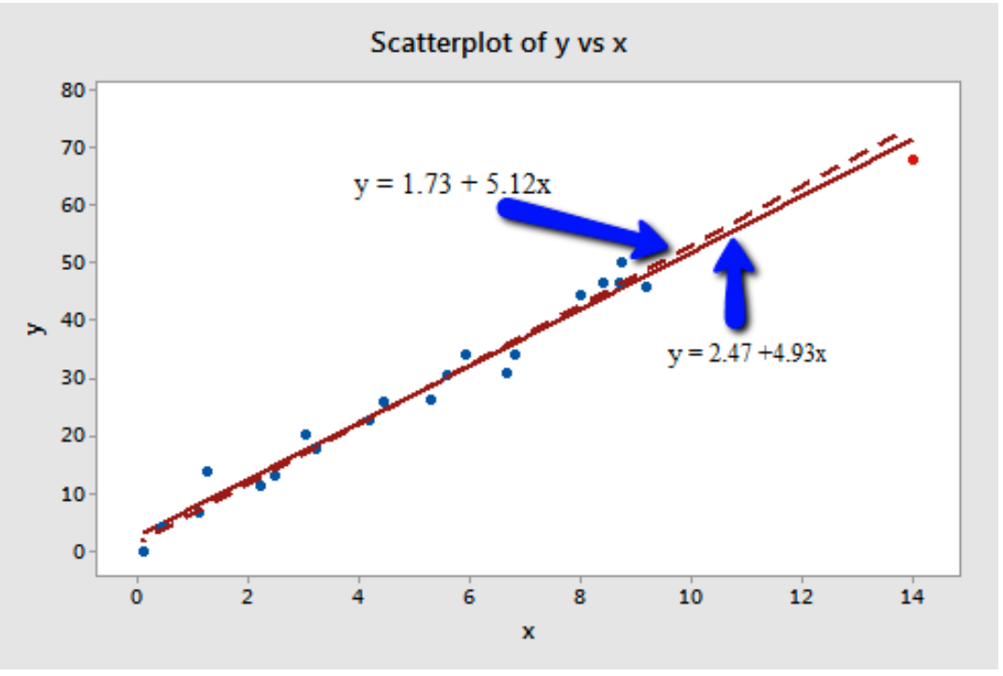
High Leverage

Slide 12
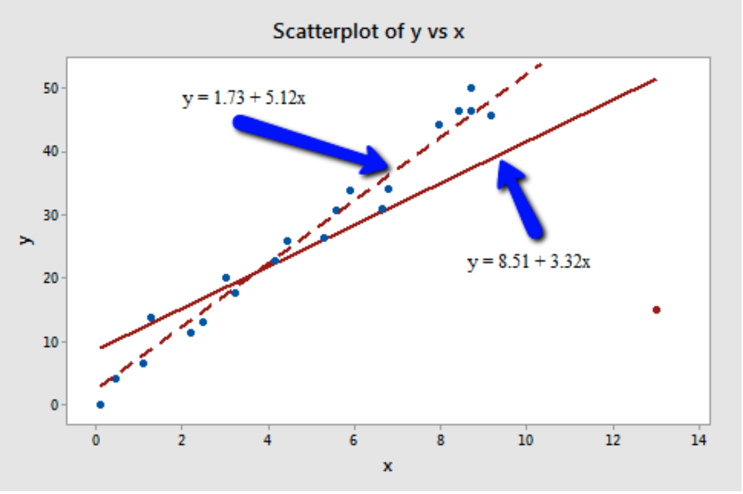
Influential point

Slide 13


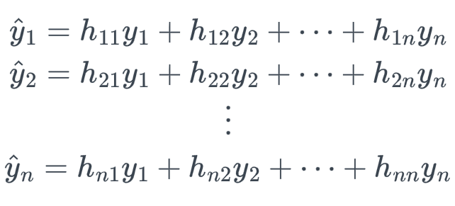



Leverage
X’ = X^{T}
h_{ii} :leverage,
Proportional to the influence of response y_{i} on its predicted value

Slide 14
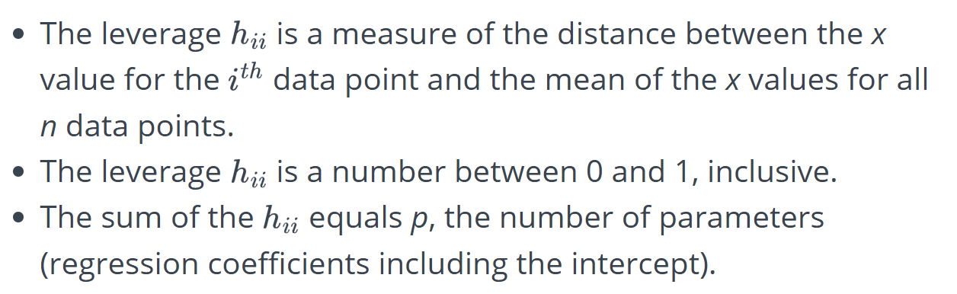
Properties of leverage

Slide 15
Risk 3 – underspecified or over-specified
How many parameters among p-1 to keep
And which ones to keep
Underfitting or underspecified system
If too many parameters are dropped
Overfitting or curse of dimensionality
If too many parameters are kept
Algorithms for parameter selection
Stepwise
Subset selection

Slide 16
Neutralizing Multicollinearity
Step 1 : How to Detect?

Slide 17
Neutralizing Multicollinearity
Step 1 : How to Detect?
Step 2 : for k in range( 1:p-1):
Fit a linear Regression of b_{k} against remaining p-1 features /parameters
Then?

Slide 18
Neutralizing Multicollinearity
Step 1 : How to Detect?
Step 2 : for k in range( 1:p-1):
Fit a linear Regression of b_{k} against remaining p-1 features /parameters
Compute R_{k}² - coefficient of determination for this fit
How to convert this R_{k} ² into a metric of collinearity

Slide 19
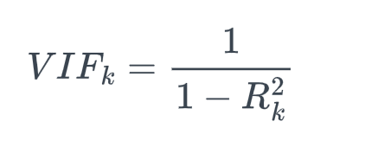
Neutralizing Multicollinearity
Step 1 : How to Detect?
Step 2 : for k in range( 1:p-1):
Fit a linear Regression of b_{k} against remaining p-1 features /parameters
Compute R_{k}² - coefficient of determination for this fit

Slide 20
Neutralizing Multicollinearity
Step 1 : How to Detect?
Step 2 : for k in range( 1:p-1):
Fit a linear Regression of b_{k} against remaining p-1 features /parameters
Compute R_{k}² - coefficient of determination for this fit
Step 3 - Rules of Thumb
VIF = 1 : no correlation between the kth predictor and the remaining predictor variables. Keep the feature
VIFs > 4 further warrant investigation . cross –validation to determine if variable can be retaind
VIFs > 10 are signs of serious multicollinearity requiring correction.

Slide 21
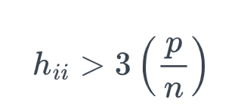
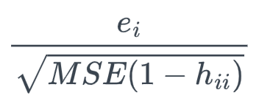

Neutralising outliers
Point to Flag
High leverage
Outlier in y
Abs (internally studentized residuals) r_{i} > 3
Influential points?
Difference in fits and Cook’s distance

Slide 22


Influential point
The i^{th} data point is influential if
Substantially different coefficients when
Line is regressed including the point Vs when the line is regressed by excluding the point
Line fit by excluding a point is called deleted-fit for that point
the predicted value of y_{i} wil be vastly different in above scenarios
The predicted value when line is fit by keeping i^{th} data point :
The predicted value when line is fit by deleting i^{th} data point :

Slide 23
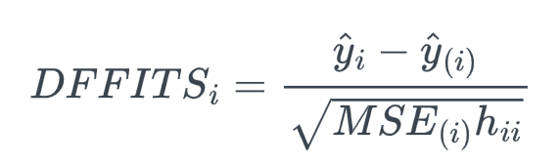

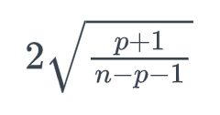
Metrics - DEFIT
Difference in fits
Flag the point if
>

Slide 24
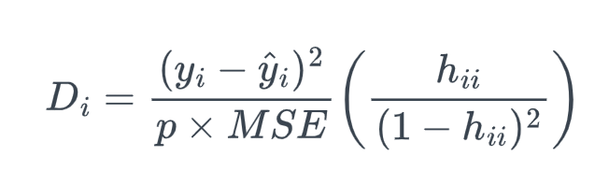
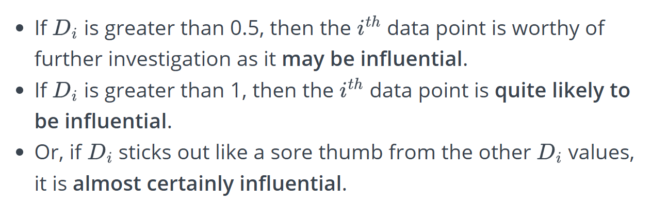
Cook’s Distance

Slide 25
MLR Steps
Test-train split
Normalise the features
Fit the first linear regression model
Observe adjusted R² for MLR and R² for SLR )and p-value
For each feature, check the pvalue of the coefficient and VIF
Drop feature with VIF>10
Use cross validation to decide if feature can be dropped in case p value is greater than 0.05 and or VIF is greater than 4 and less than 10
Check Cook’s Distance and DEFITs distributions. If any points have unusual value for either of these , check if dropping those points help in improving line fit. (use cross validation)
•Fit the line and check coefficient p-values and magnitude .
•Identify all features with pvalue greater than 0.05 and sort in descending order of pvalue
•From the above list drop features one by one and fit line until you don’t observe any drop in adjusted R²
Check line conditions
Use residual analysis to identify if any non-linear transformations of X or y is required.
Fit the line again.
Report accuracy on test data set.

Slide 26
Practice Questions
Analyse how quality of fit is assessed in multiple linear regression.
Analyse issues caused by multicollinearity in multiple linear regression
Describe the process to deal with multicollinearity in linear regression.
Explain how impact of outliers is measured and how they are tackled.
What is the method to reduce the number of input features in multiple linear regression. ?

